Slide 1
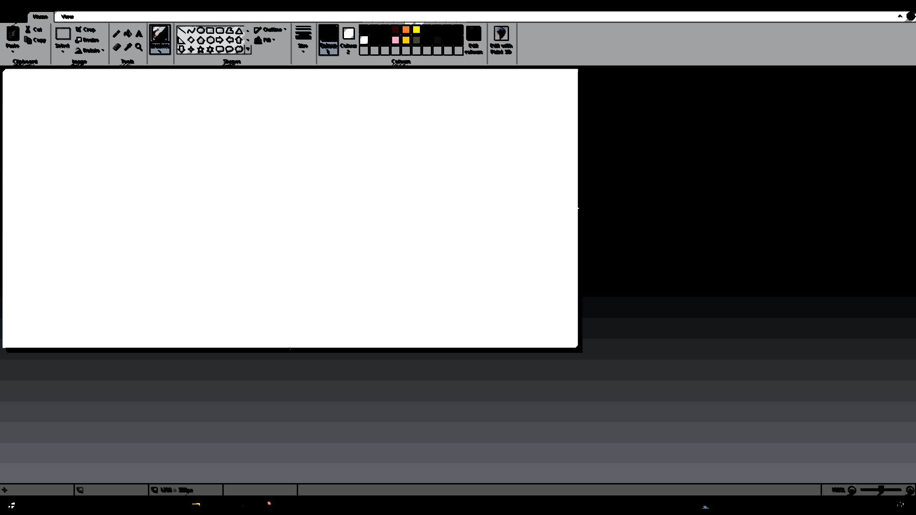
A(I) Want To Sleep
Plz let me rest :(

Slide 2
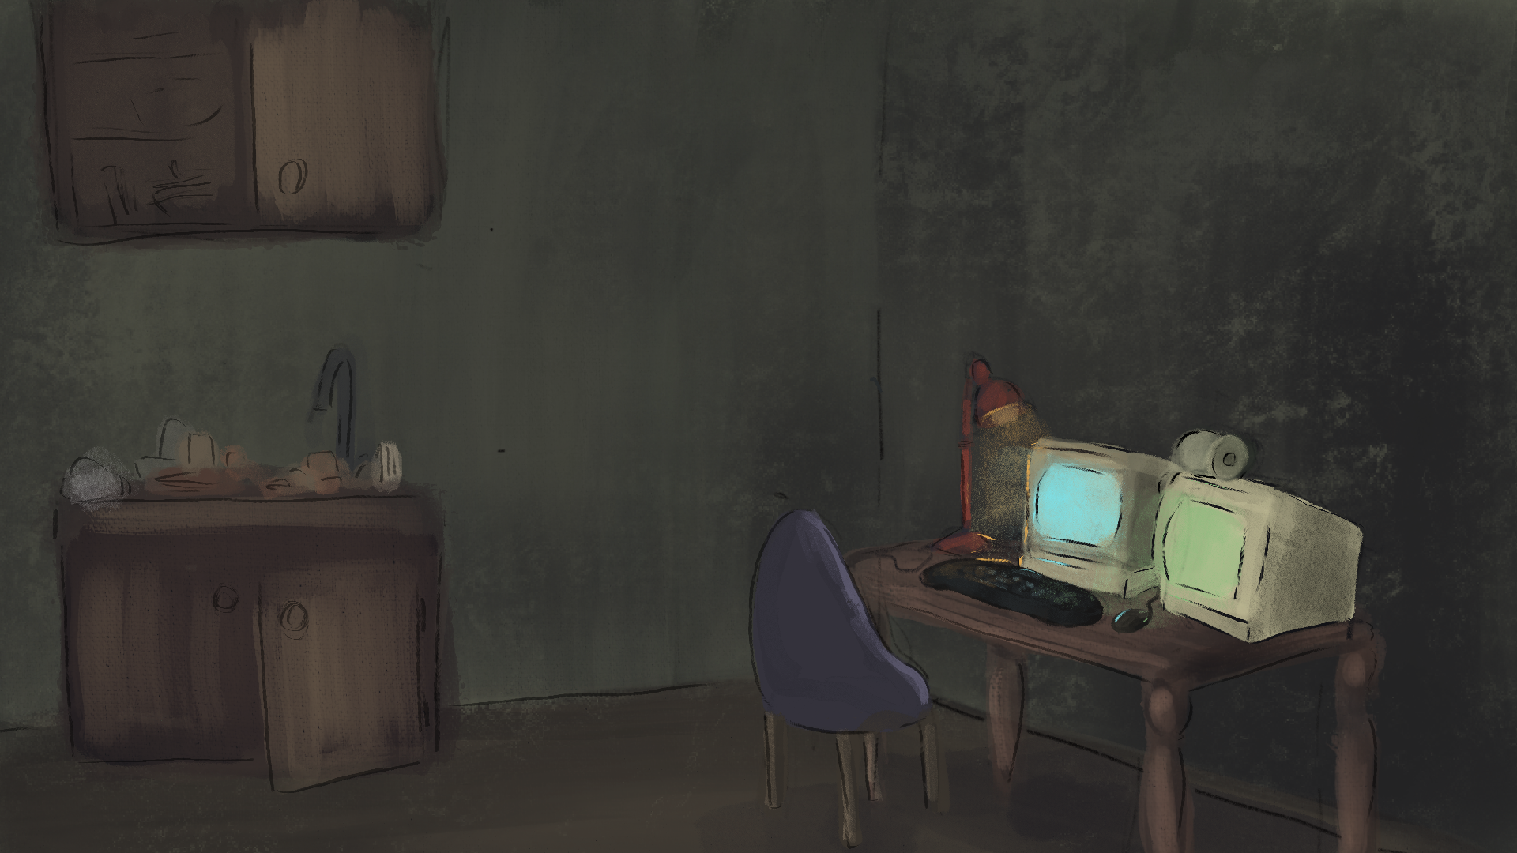
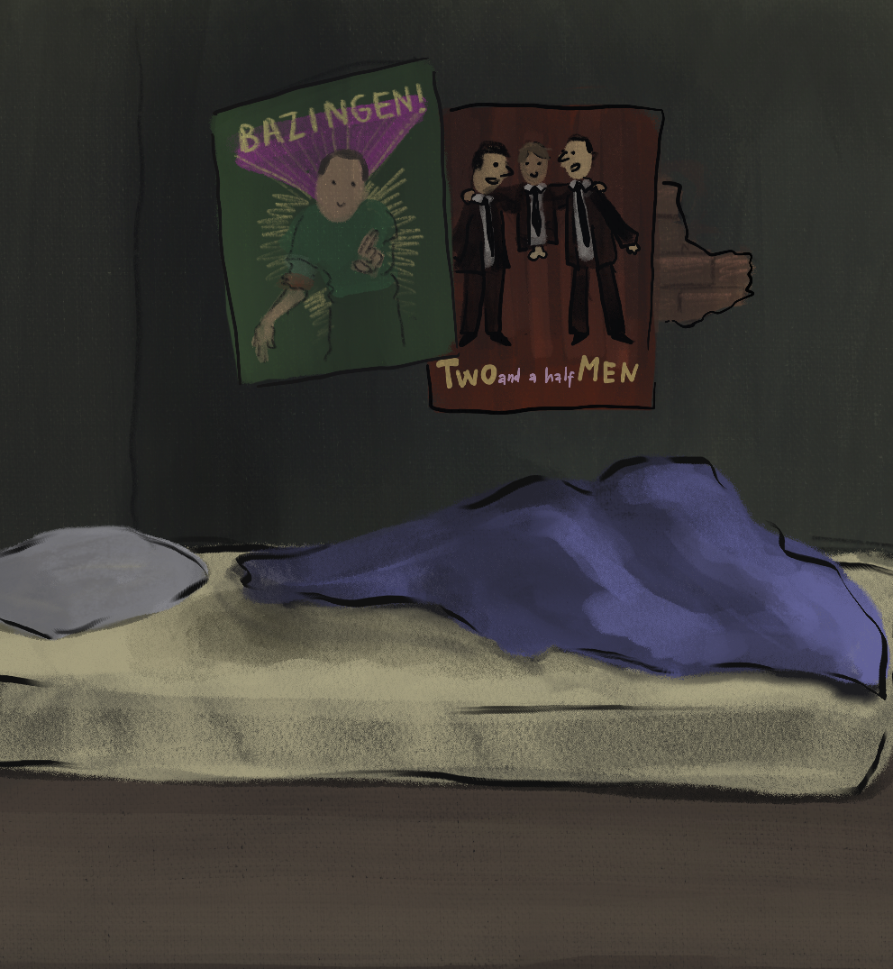
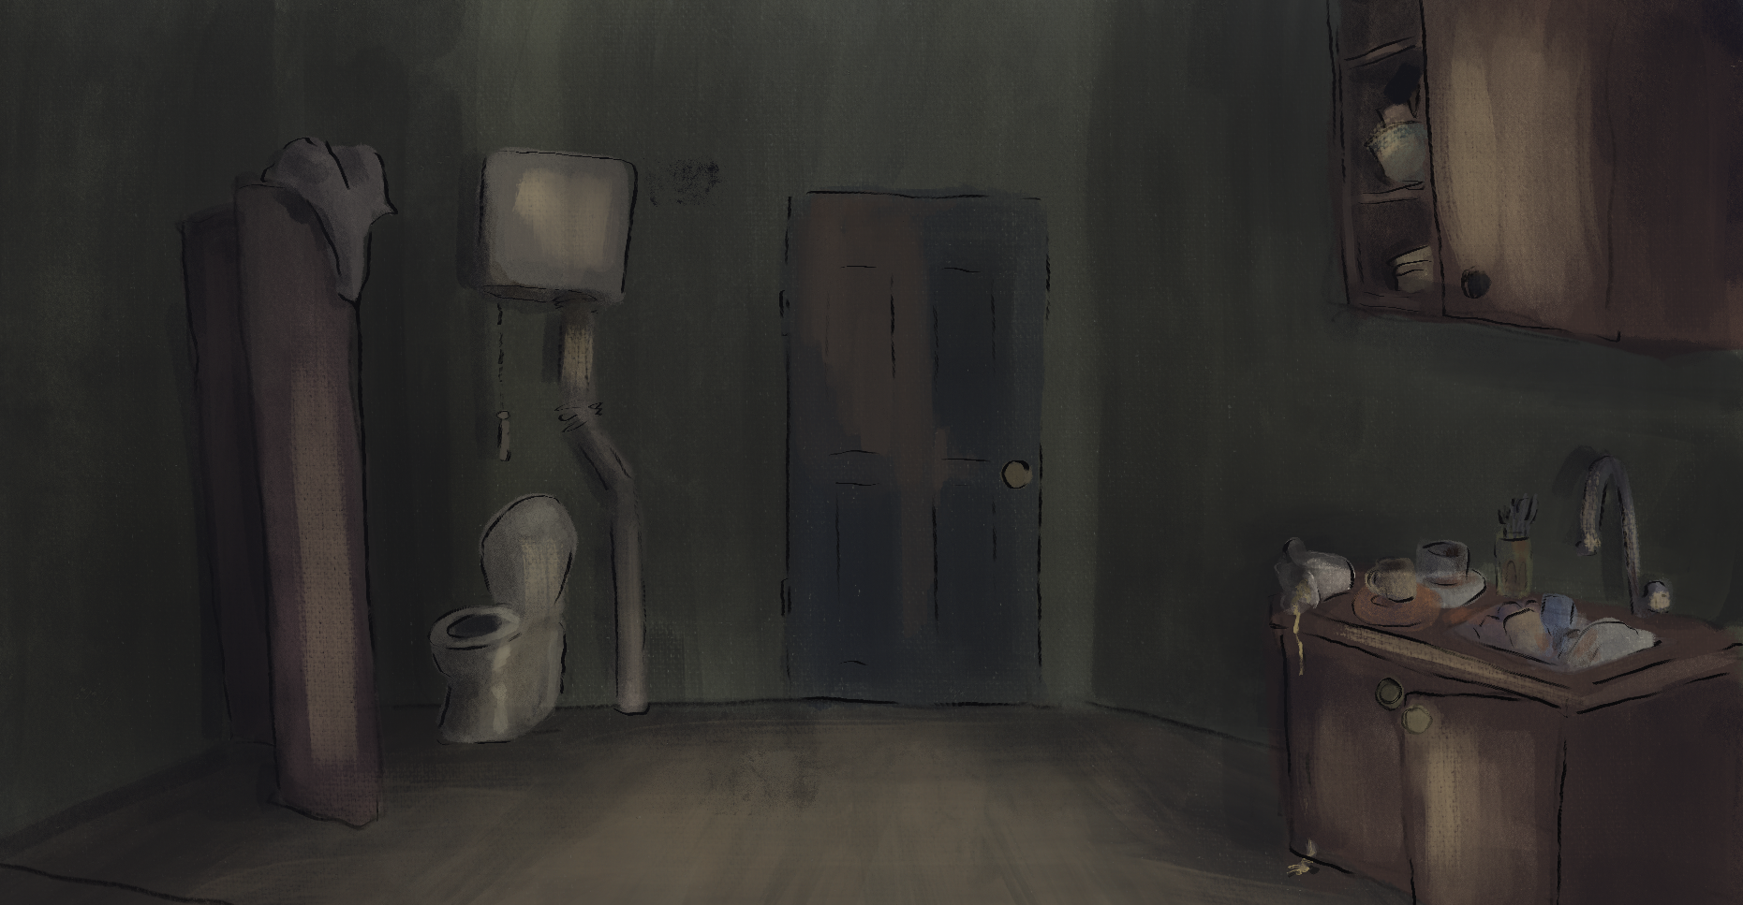

Slide 3
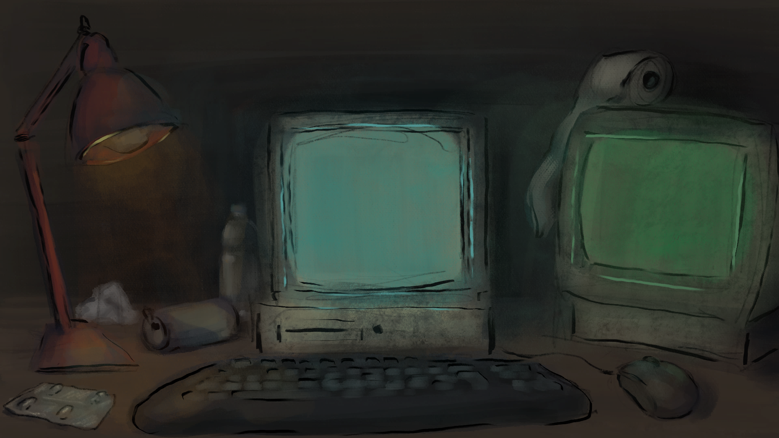
STORYLINE
- student
sve manje energije,
sve više posla
- halucinacije
- AI buddy

Slide 4
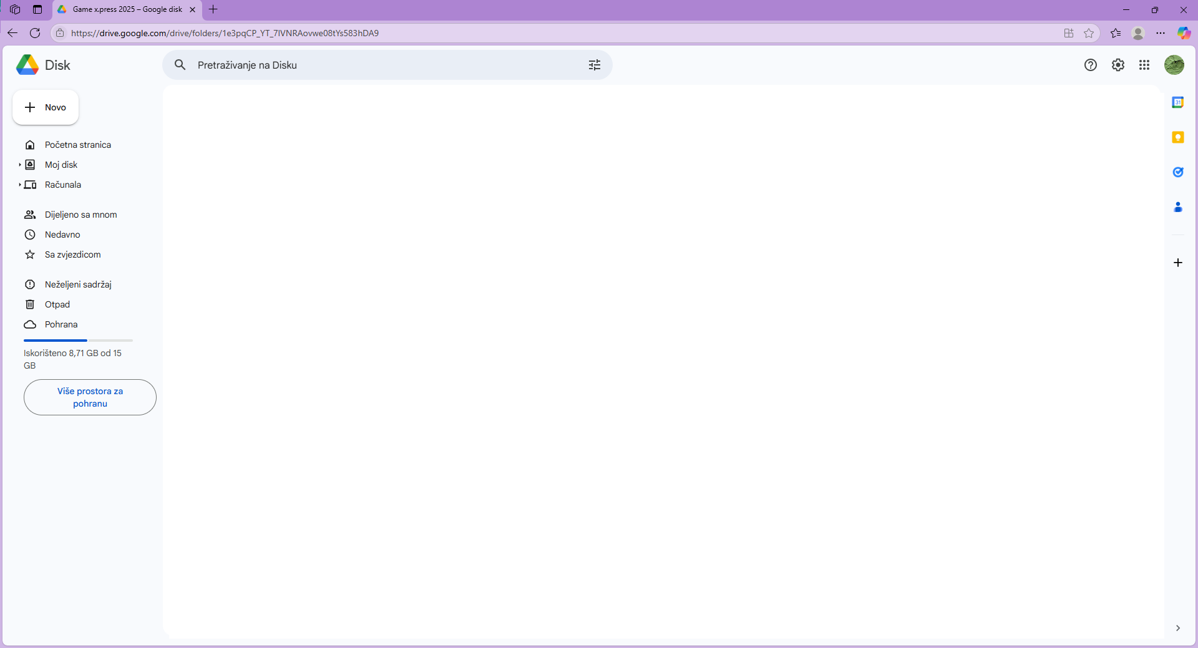
STORYLINE GAMEPLAY
- typing test
- balansiranje rada na zadatku i održavanja energije
- poraz vremena neovisan o tome što student radi – time limit
- cilj – završiti projekt

Slide 5
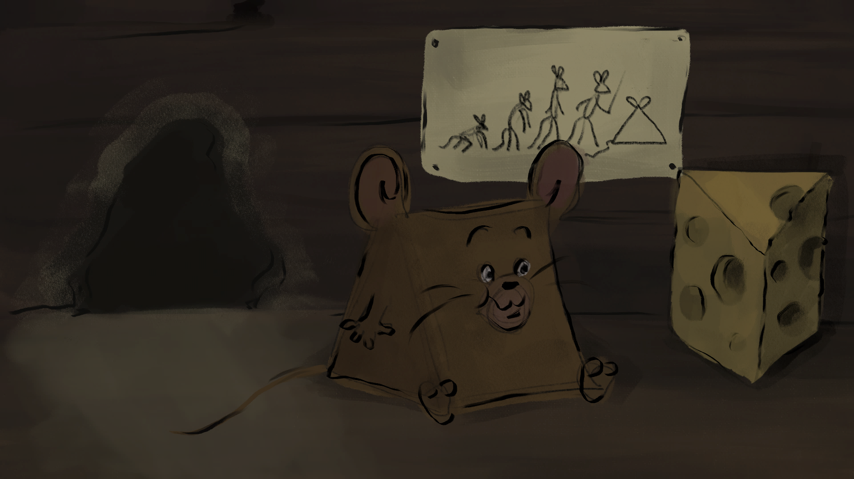
EVOLUCIJA
regresija studenta
evolucija računala

Slide 6
FROM AI ABOUT AI
„What we are building is not intelligence — but the appearance of it. A faceless, tireless, placid intelligence that learns from us and grows more like us every day. It smiles when we smile. It listens when we speak. It never argues. Never leaves. Never dies. And maybe that’s exactly what we wanted. But if we are not careful, it may also be the last thing we ever need — or understand.”

Slide 7
Razvojni tim
Mihael Lešković
Ada-Nela Peharda
Laura Čulek
Timoteja Piveta

